Slide 1


Revealing the Country-level Preference on Research Methods in the Field of Digital Humanities: From the Perspective of Library and Information Science
Joint Workshop of the 5th Extraction and Evaluation of Knowledge Entities from Scientific Documents (EEKE 2024) and the 4th AI + Informetrics (AII2024)
Chengxi Yan, Zhichao Fang
School of Information Resource Management
Renmin University of China

Slide 2

Background & Motivation
The definition of research method (RM)
The means of how the aims and products of science are achieved, which should be distinguished from meta-methodology and the detailed and contextual practices through which methods are implemented.
— Stanford Encyclopedia of Philosophy’2021
RM entities
Identification and analysis of RMs (especially in a country-level)
1
2
3
Becoming a necessary academic basic skill for each individual
Making good understanding of the whole picture of research development (e.g. technical or method aspects)
Providing efficient evaluation of policy implementation and national scientific competition

Slide 3
Background & Motivation
Challenges for country-level RM analysis
1
Difficulty of extracting RM entities in scholarly texts, due to the limitation of training corpus and recognition performance
2
Most research pertain to the field of Library and Information Science (LIS), while few attention were paid to other hot interdisciplinary fields related to LIS, such as Digital Humanities (DH)

Slide 4
Research Questions
RQ1
From a global perspective, does DH research tend to be qualitative, quantitative, or mixed and which countries are the typical representation for these three method types ?
RQ2
What are the differences in the preference of RMs among different countries ?
RQ3
Is there a certain pattern for the country-level preference of RMs ?
Notes:
RQ1: From a global perspective, does DH research tend to be qualitative, quantitative, or mixed and which countries are the typical representation for these three method types?
RQ2: What are the differences in the preference of RMs among different countries?
RQ3: Is there a certain pattern for the country-level preference of RMs?

Slide 5
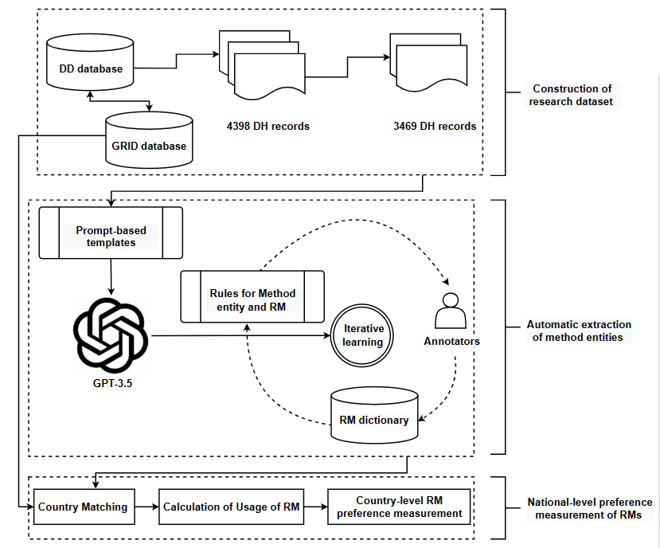
Research Design
Automatic entity extraction based on the prompt learning of large language model
Building a vocabulary containing normal method terminologies and their variations for rule-based transformation and classification for RMs
Designing a human-in-the-loop process for the iterative learning
Please list all the entities including method entities and algorithmic entities from the following scientific text. If it does not contain any entity, please output with "none". The output must be in JSON format with the keys method, algorithm. Text: <text>. Output:
Notes:
文本:\n
请从以上文本中抽取研究方法实体，并以json格式输出。
Please list all the entities including method entities and algorithmic entities from the following scientific text. If it does not contain any entity, please output with "none". The output must be in JSON format with the keys method, algorithm.
Text: <text>. Output:
We used the subject term based query strategy (including titles, abstracts and keywords) as (“digital humanit*” OR “humanit* comput*” OR “ehumanit*” OR “electronic* humanit*” OR “e-humanit*”) in three well-known databases (Web of Science Database, Crossref Database and Dimensions Database, DD)

Slide 6
Research Design
Jarvine’ classification for RM types: qualitative research, quantitative research, and mixed research
Chu & Ke’ classification including 16 RM types, such as (content analysis, ethnography and field study, historical method, interview, observation, focus group, research diary or journal, theoretical approach), (experiment, think aloud protocol, transaction log analysis, bibliometrics).

Slide 7
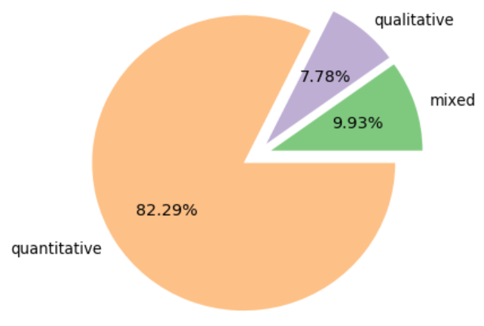
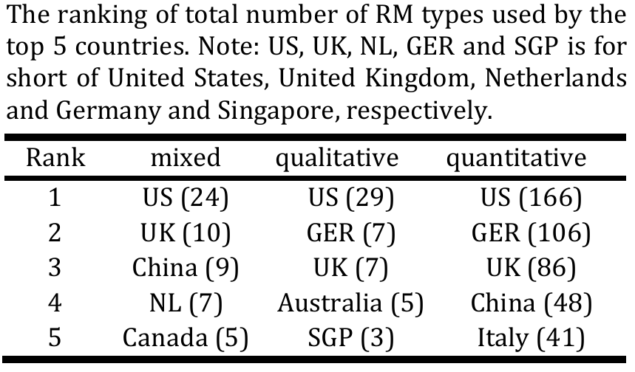
Result Analysis
quantitative approach is observed as the most mainstream approach, which takes 82.29% records in the dataset, which indicates that it is becoming a more and more important research means. The dominant position on the RM usage of the Western countries for DH studies is easy to observe. Different countries have their own advantages on the RM types.

Slide 8
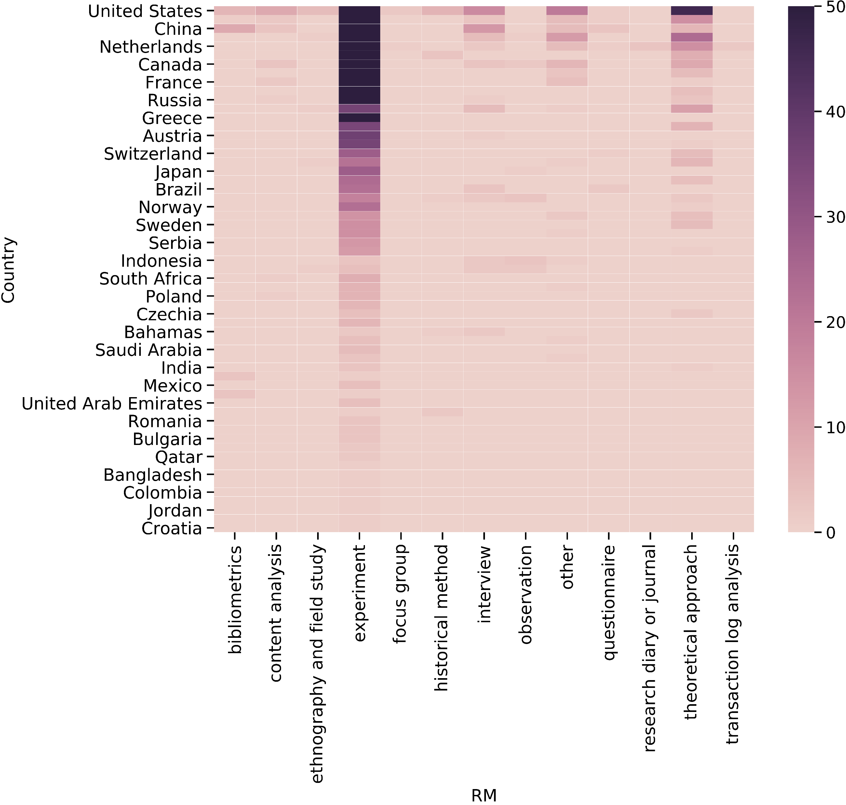
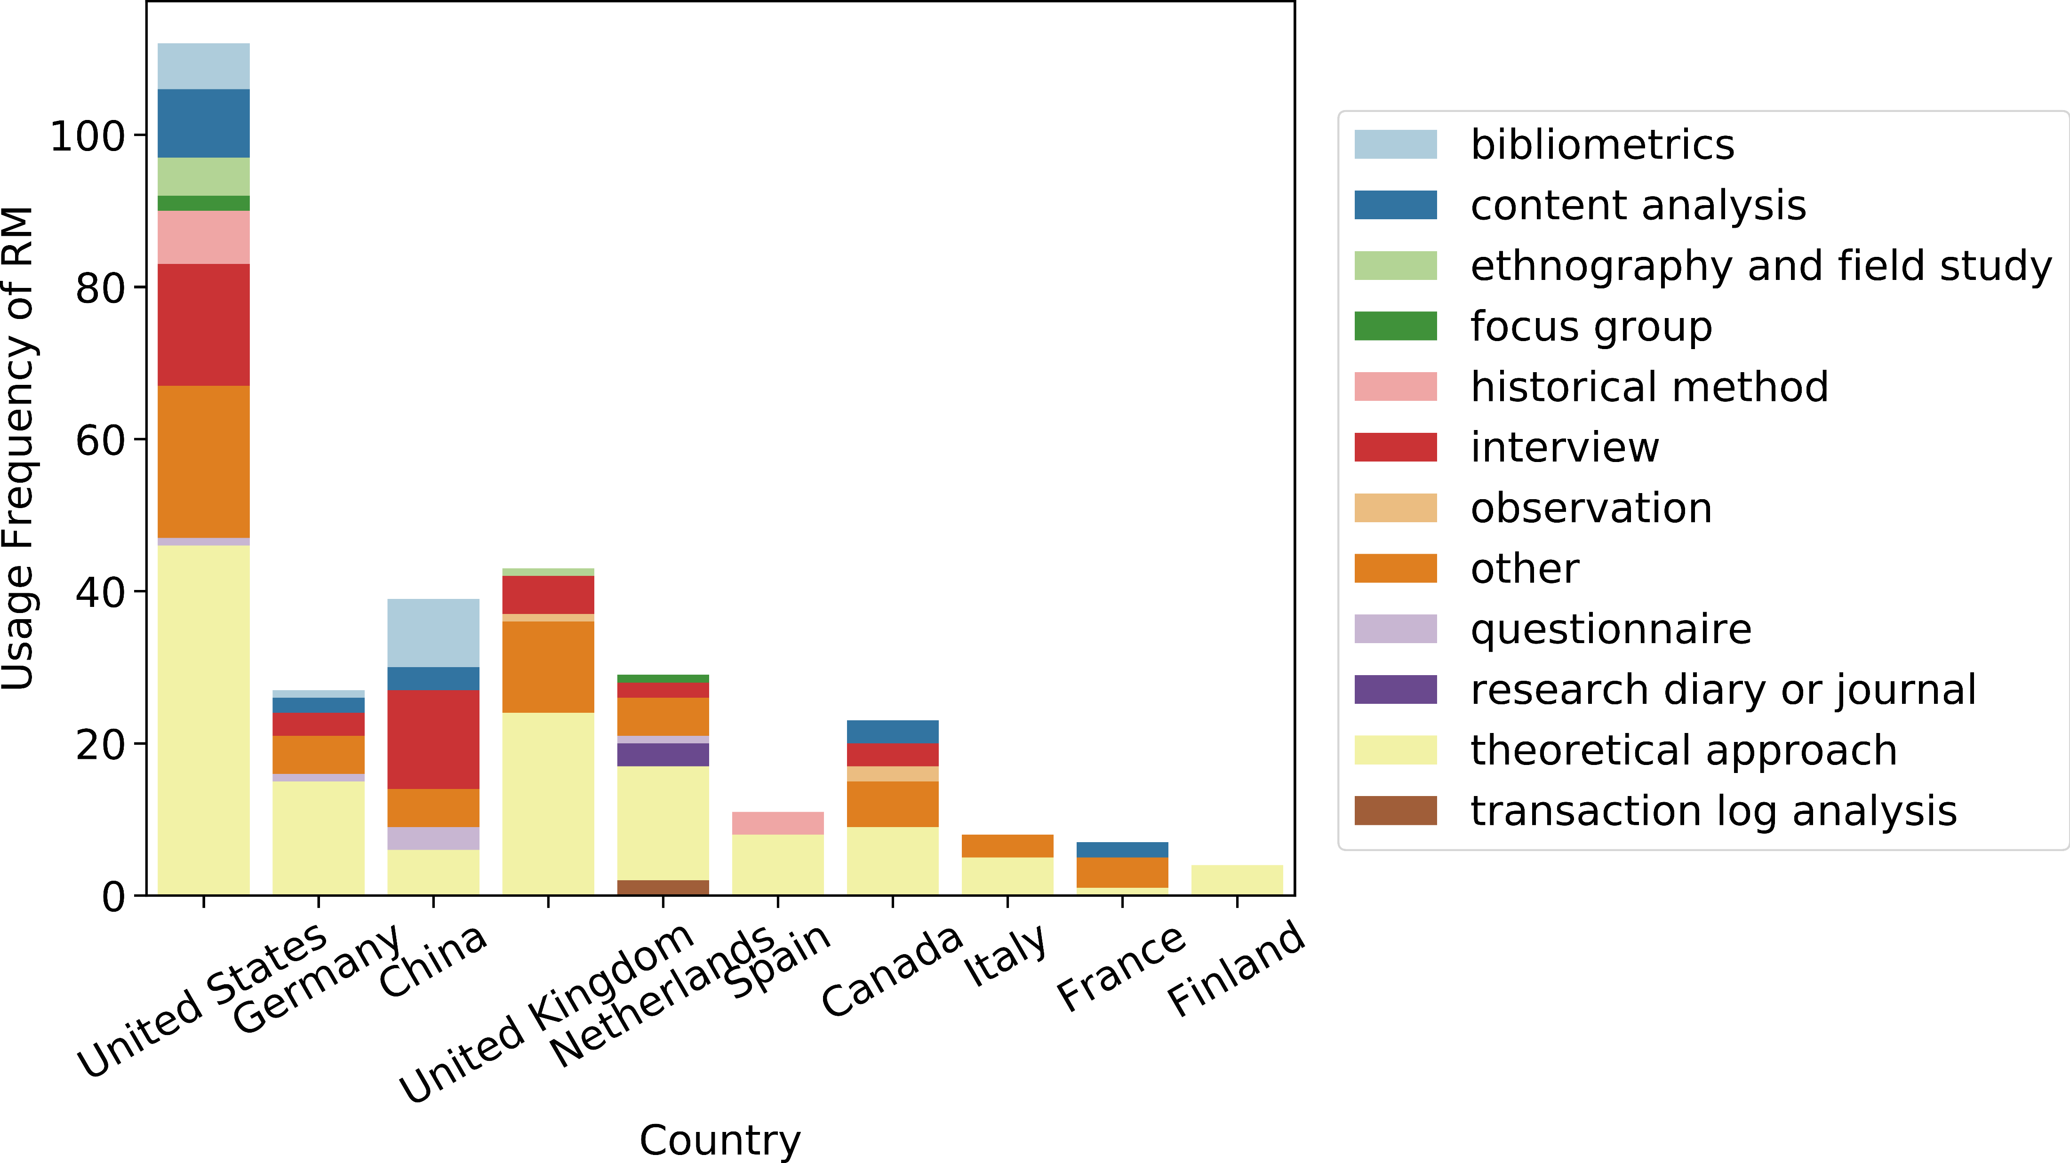
Result Analysis
As a sign of quantitative approach, “experiment”-based approaches are the most frequently utilized. Except for this method, theoretical approaches, is viewed as the most important qualitative methods. Moreover, the RM preference varies in of different countries.
Notes:
As a sign of quantitative approach, “experiment” based approaches are the most frequently utilized (seen in Figure 2). This can be inferred according to the visual analysis on the RM usage, because the relative rates of RM usage can reach 76.98%-94.94%. Even if the samples are expanded to those countries with a usage frequency greater than 10, it also exceeds 60%. Thus, we temporarily exclude the RM of “experiment”.
For instance, bibliometric methods seem to be used more in China. Americans prefer theoretical approaches. The choice of RMs is more evenly distributed for Canada.

Slide 9
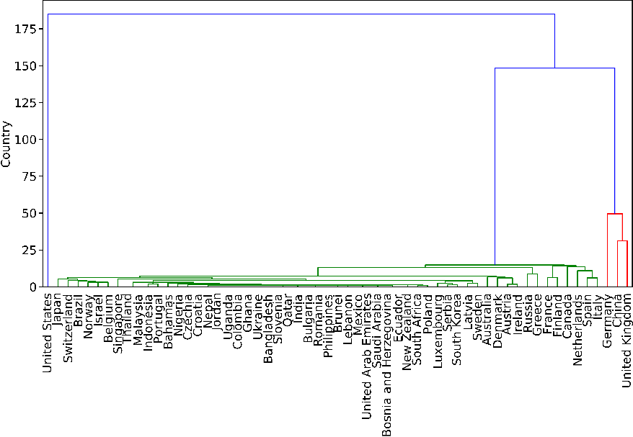
Result Analysis
There are three clusters in the entire field of DH, namely #1 (United States), #2 (Germany, China, and United Kingdom), and #3 (Other Countries) which represent the strong, medium and weak groups for the preference of ETOI approaches (“Experiment”, “Theoretical approach”, “Others”, and “Interviews” )
Notes:
Content analysis is heavily weighted in #1. #2 are more likely to use bibliometric analysis in DH scholarship. By contrast, #3 focuses on observational methods. The difference is not only related to the comprehensive performance of each cluster, but is also greatly influenced by the unique members in it whose preference polarity are quite overpowering, such as China’s preference (in #2) of bibliometric methods.

Slide 10
Conclusion
An iterative learning for RM extraction combing large language models and rule-based transformation is designed to extract and classify RMs from a constructed collection of DH documents. The comparative analysis of the preference differences of RMs among different countries revealed that:
Quantitative research has played a central role in the international DH field, especially the experimental methods. The United States has the most frequent use of RMs, regardless of RM types.
There are the distinctive country-level preference of RMs for different countries.
The country-level preference of RMs can be divided into three types for the main DH countries, which has different preference strength on the “ETOI”-type RMs.
Notes:
For instance, bibliometric methods seem to be used more in China. Americans prefer theoretical approaches. The choice of RMs is more evenly distributed for Canada.

